Slide 1
A FireMonkey “Blur Behind” control
Erik van Bilsen
erik@grijjy.com
blog.grijjy.com
https://embt.co/CodeRage2019

Slide 2
Overview
We are going to create a small control that blurs whatever is behind it
It uses TControl.PaintTo to render the parent control to an off-screen bitmap
Followed by a GPU accelerated TGaussianBlurEffect to blur part of the bitmap
And finally draws the blurred bitmap to the canvas of the control
Erik van Bilsen

Slide 3
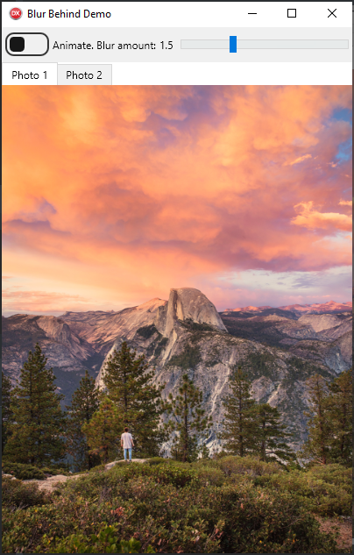
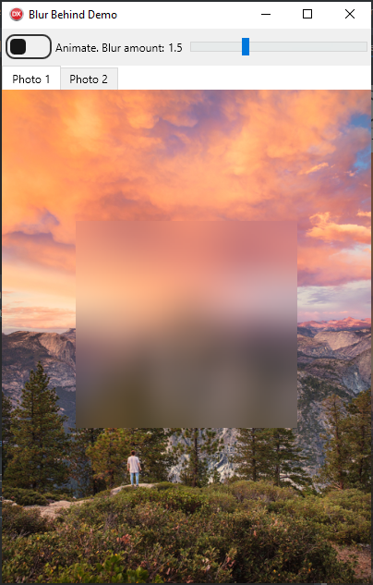



Process
2. Copy Region Of Interest to separate bitmap
3. Blur bitmap
1. Draw parent control to off-screen bitmap
4. Draw bitmap to control

Slide 4

Optimizations
2. Copy Region Of Interest (reduced)
to separate bitmap
3. Blur bitmap
1. Draw parent control to reduced-size off-screen bitmap
4. Draw and stretch bitmap to control

Slide 5
More Information
The code:
github.com/grijjy/CodeRage2019
Our blog:
blog.grijjy.com
Me:
erik@grijjy.com

